Slide 1
Payrolled employments by nationality
Ammar Ljubijankic Kutasi, economist

Slide 2
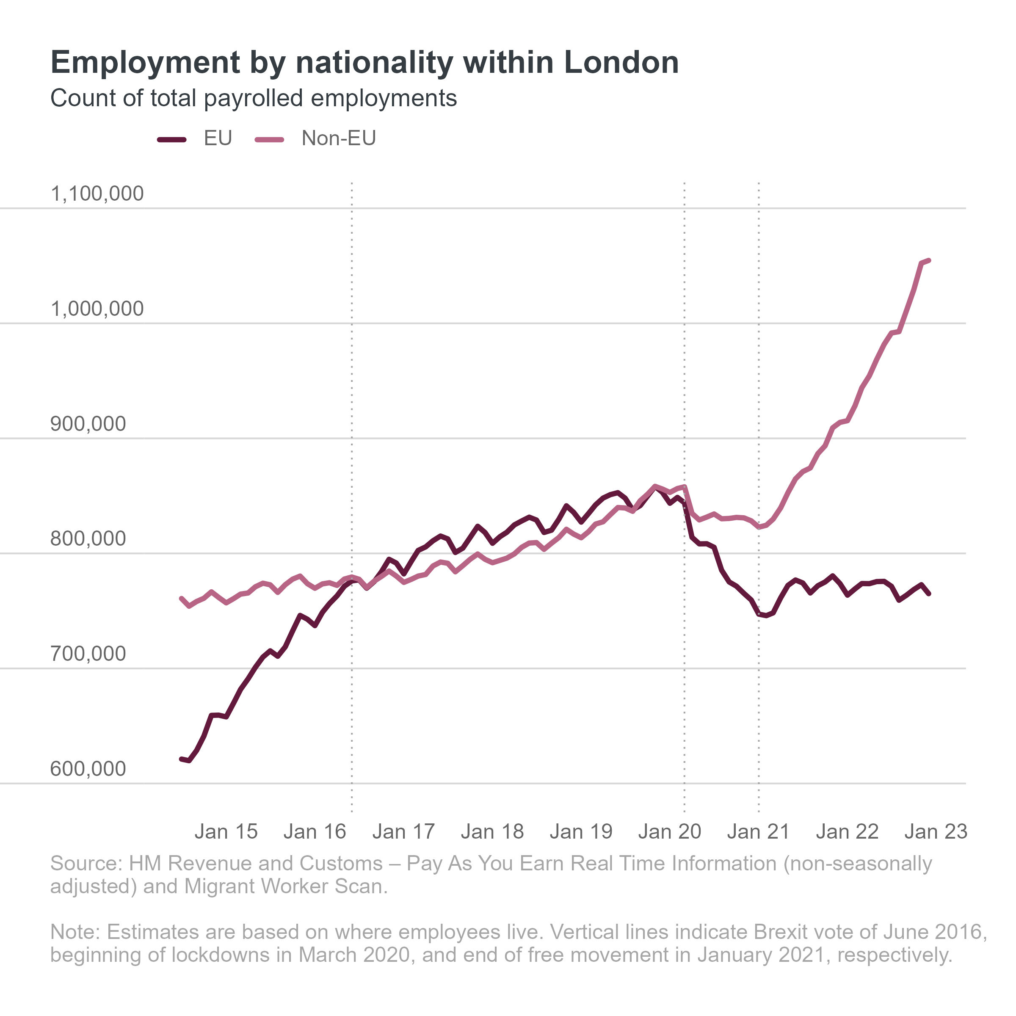
Non-EU workers lifted London’s labour market as EU workers decreased
Source: HM Revenue and Customs – Pay As You Earn Real Time Information (non-seasonally adjusted) and Migrant Worker Scan. Note: Estimates are based on where employees live. Vertical lines indicate Brexit vote of June 2016, beginning of lockdowns in March 2020, and end of free movement in January 2021, respectively.

Slide 3
Non-EU workers tend to have more employments than others
Notes:
Chart is based on NSA employments vs. NSA employees. Non-EU have more employments throughout and especially from 2020 onwards, which means their growth in employment share happens faster

Slide 4
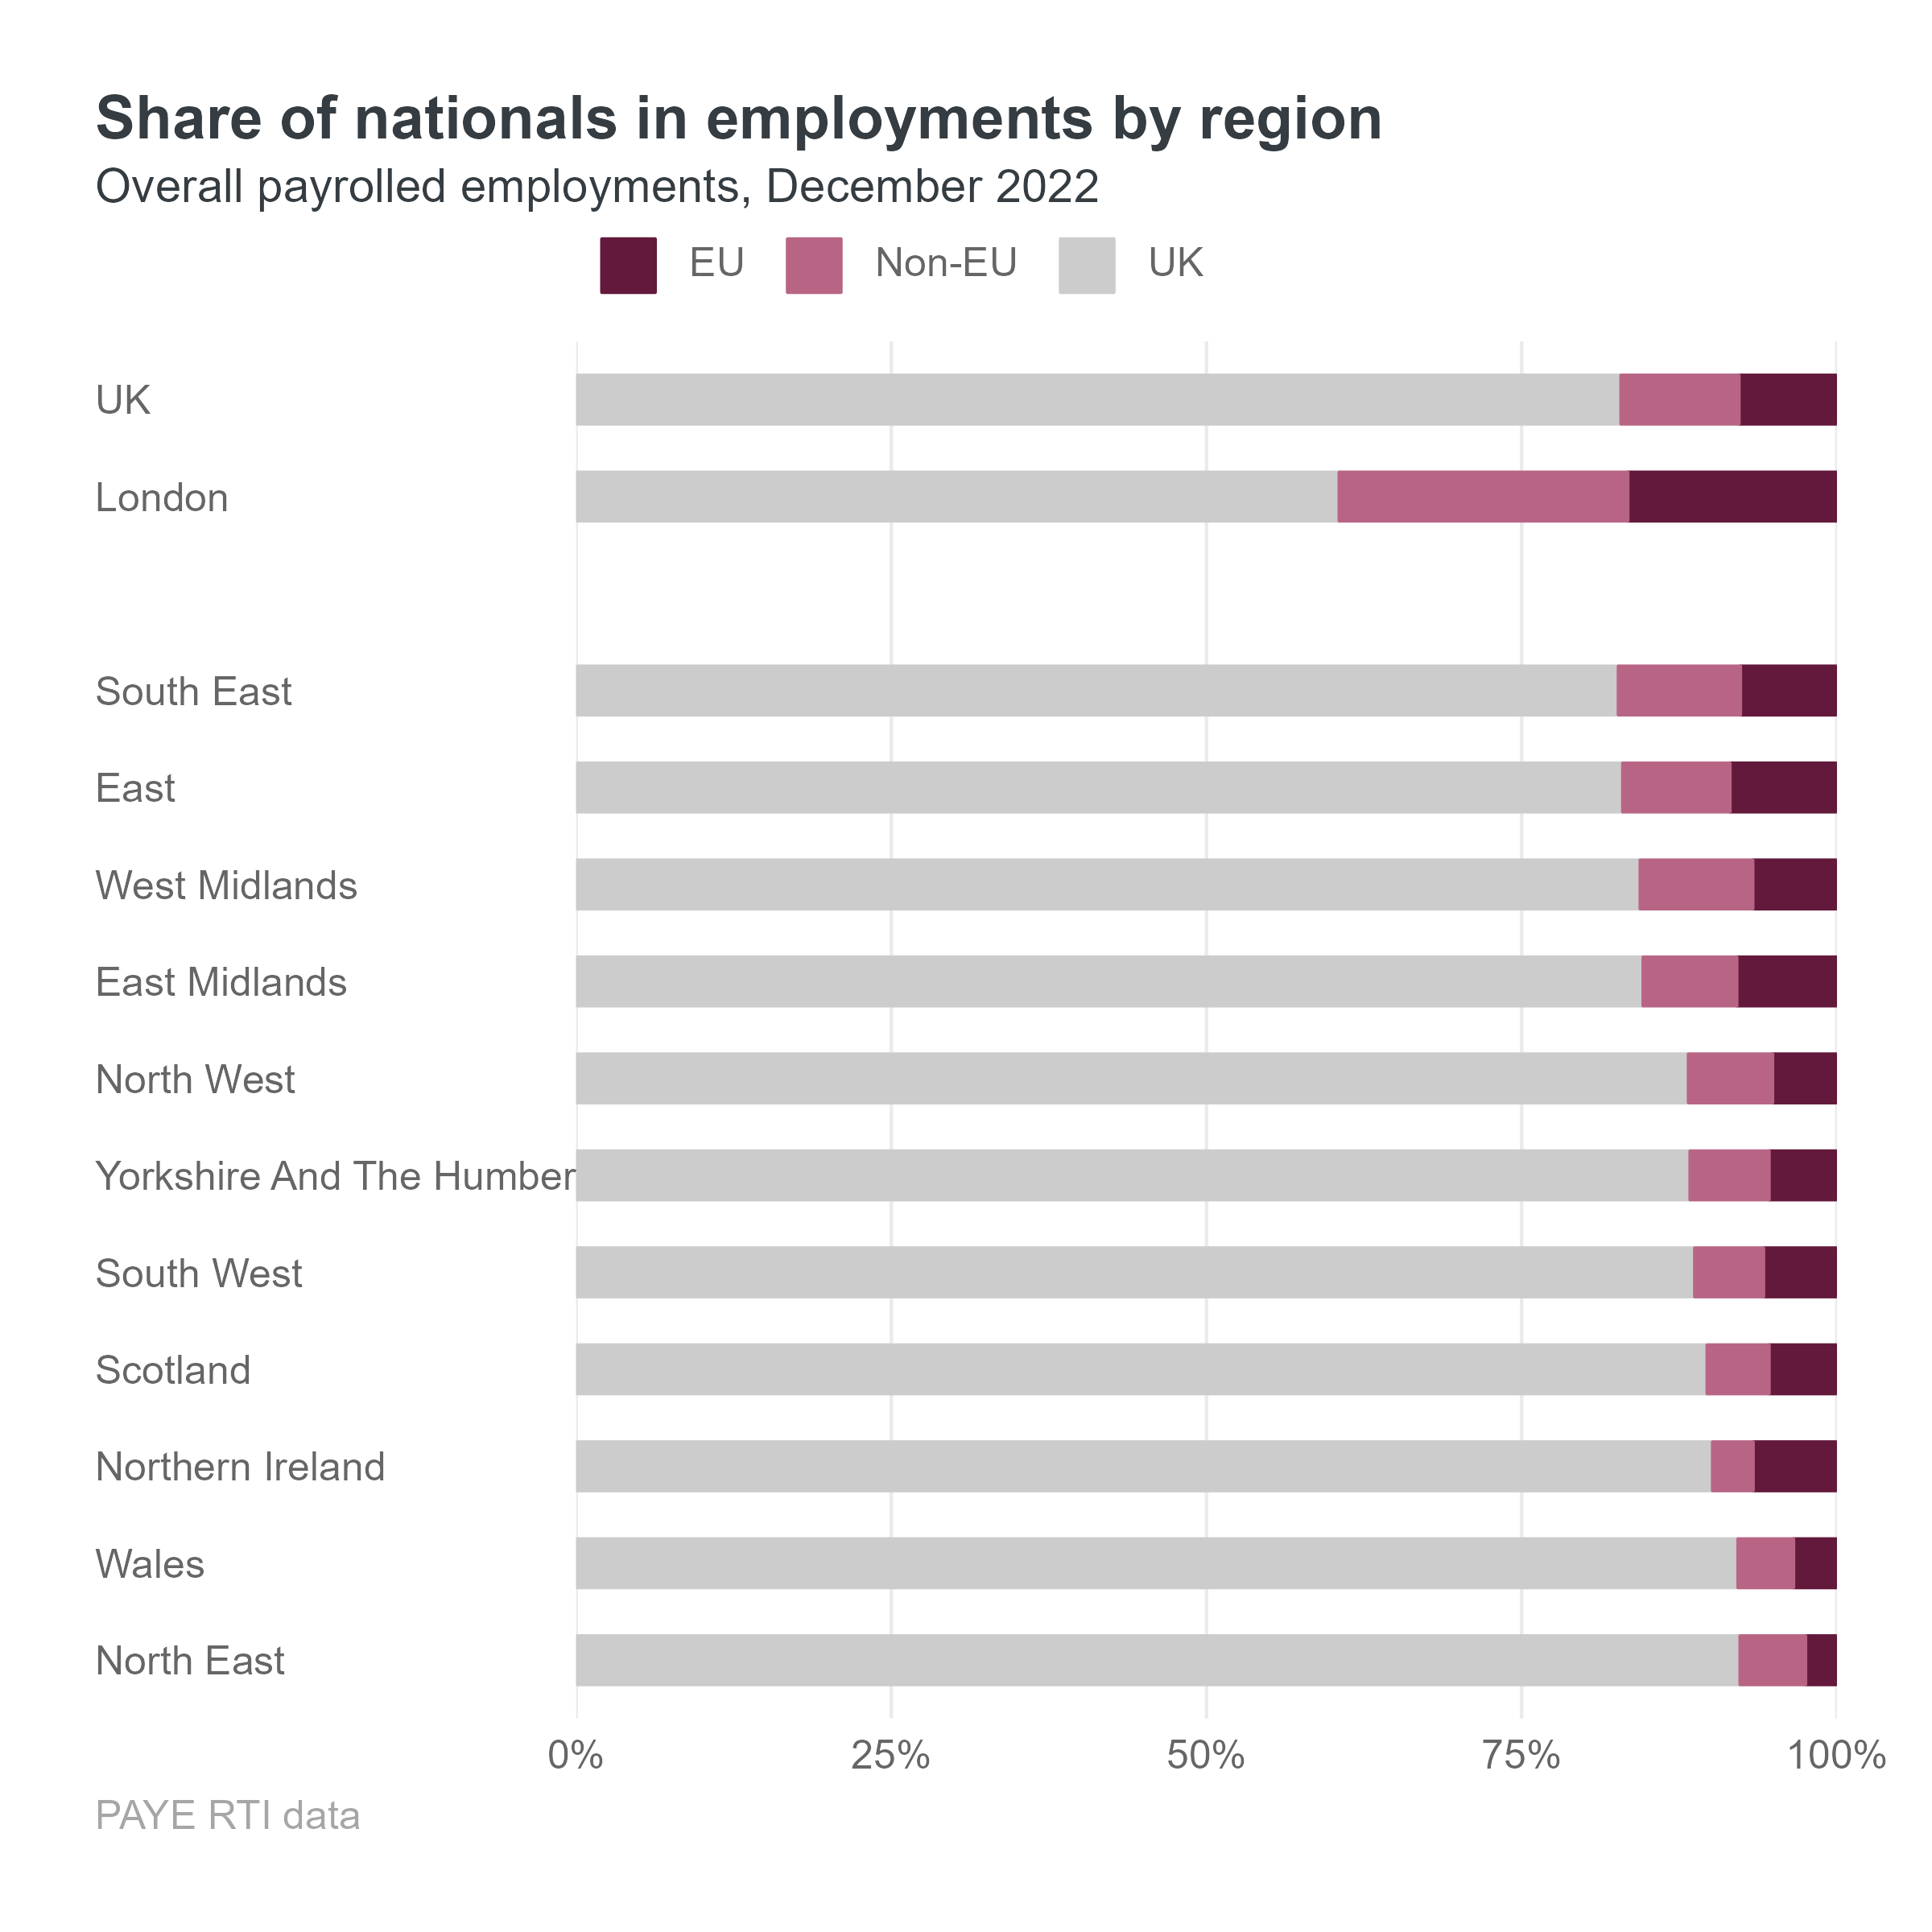
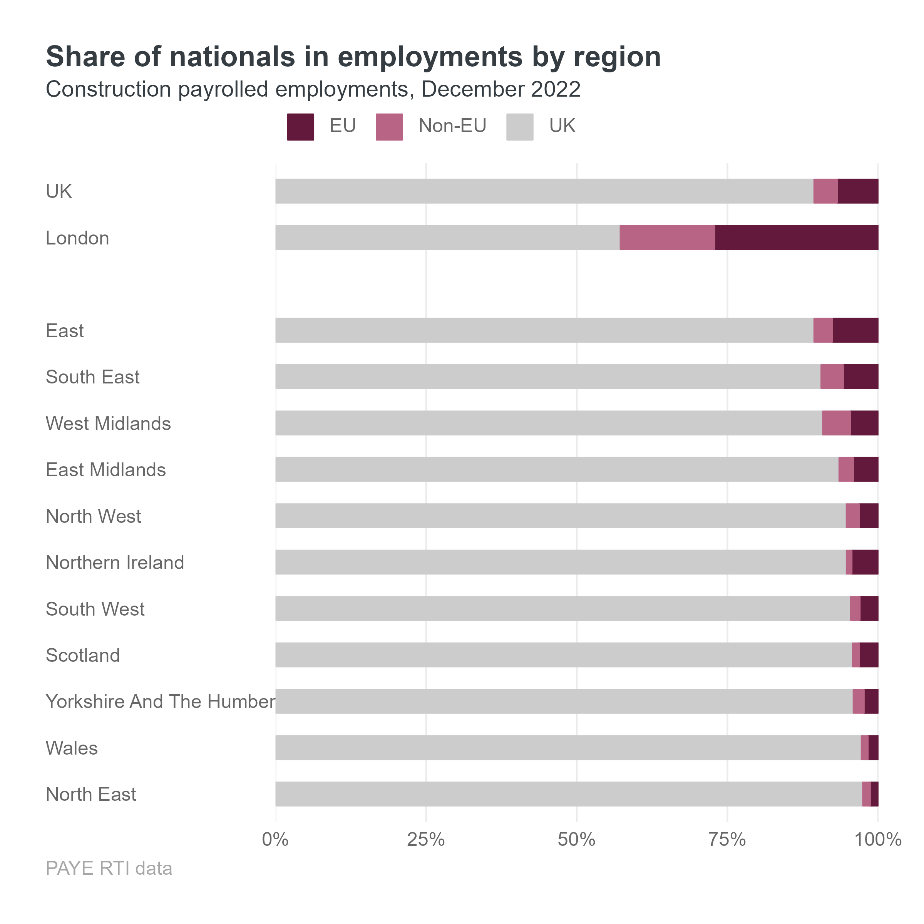
London has more than double the share of non-UK workers relative to UK average
Notes:
Overall, London has (16.6+22.9)=39.5% while UK has (7.8+9.3)=17.1%, so 2.3 times higher. In construction, it is 42.7% vs. 10.6%, so 4 times higher.

Slide 5
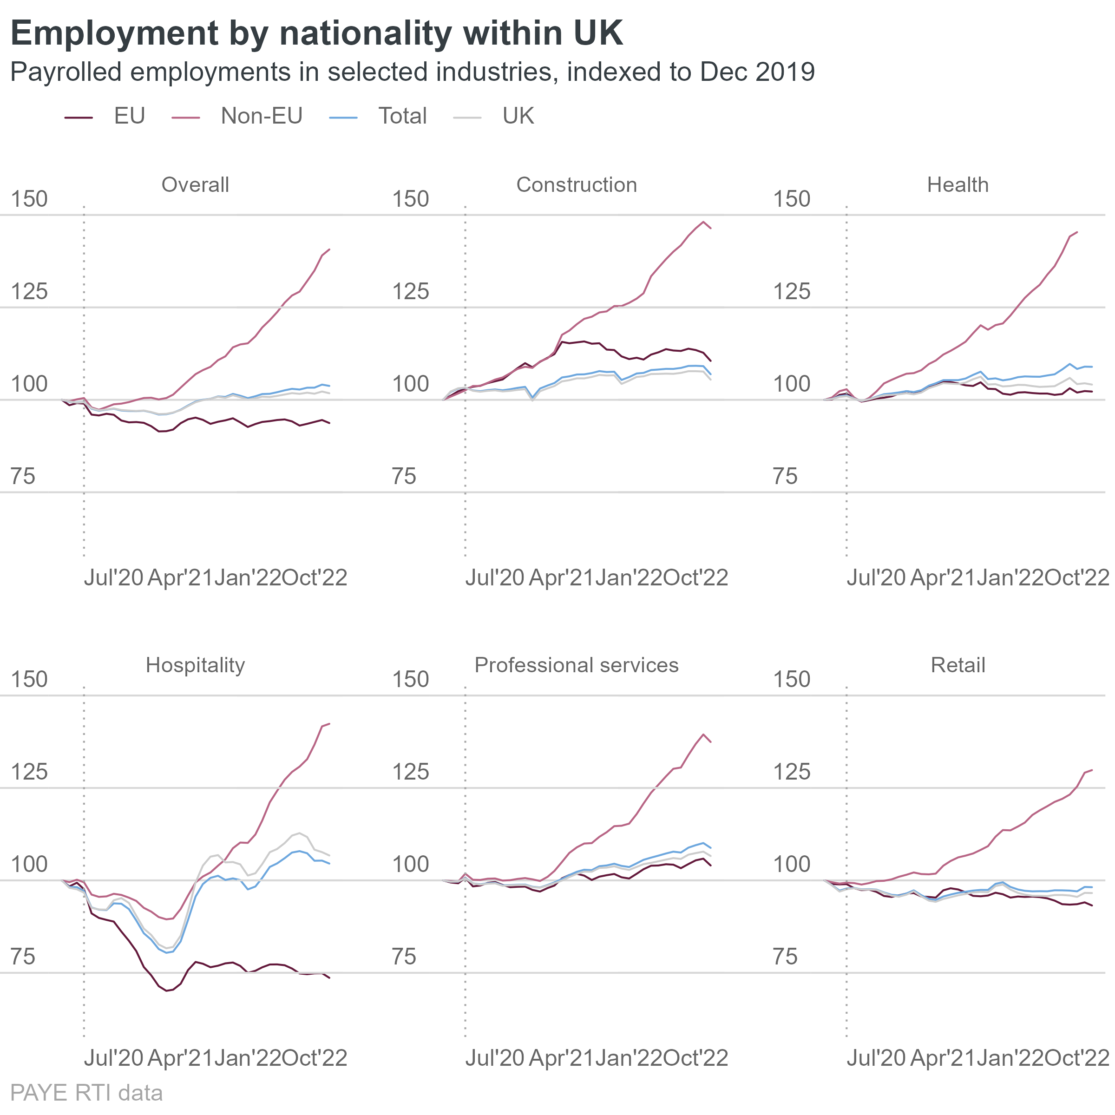
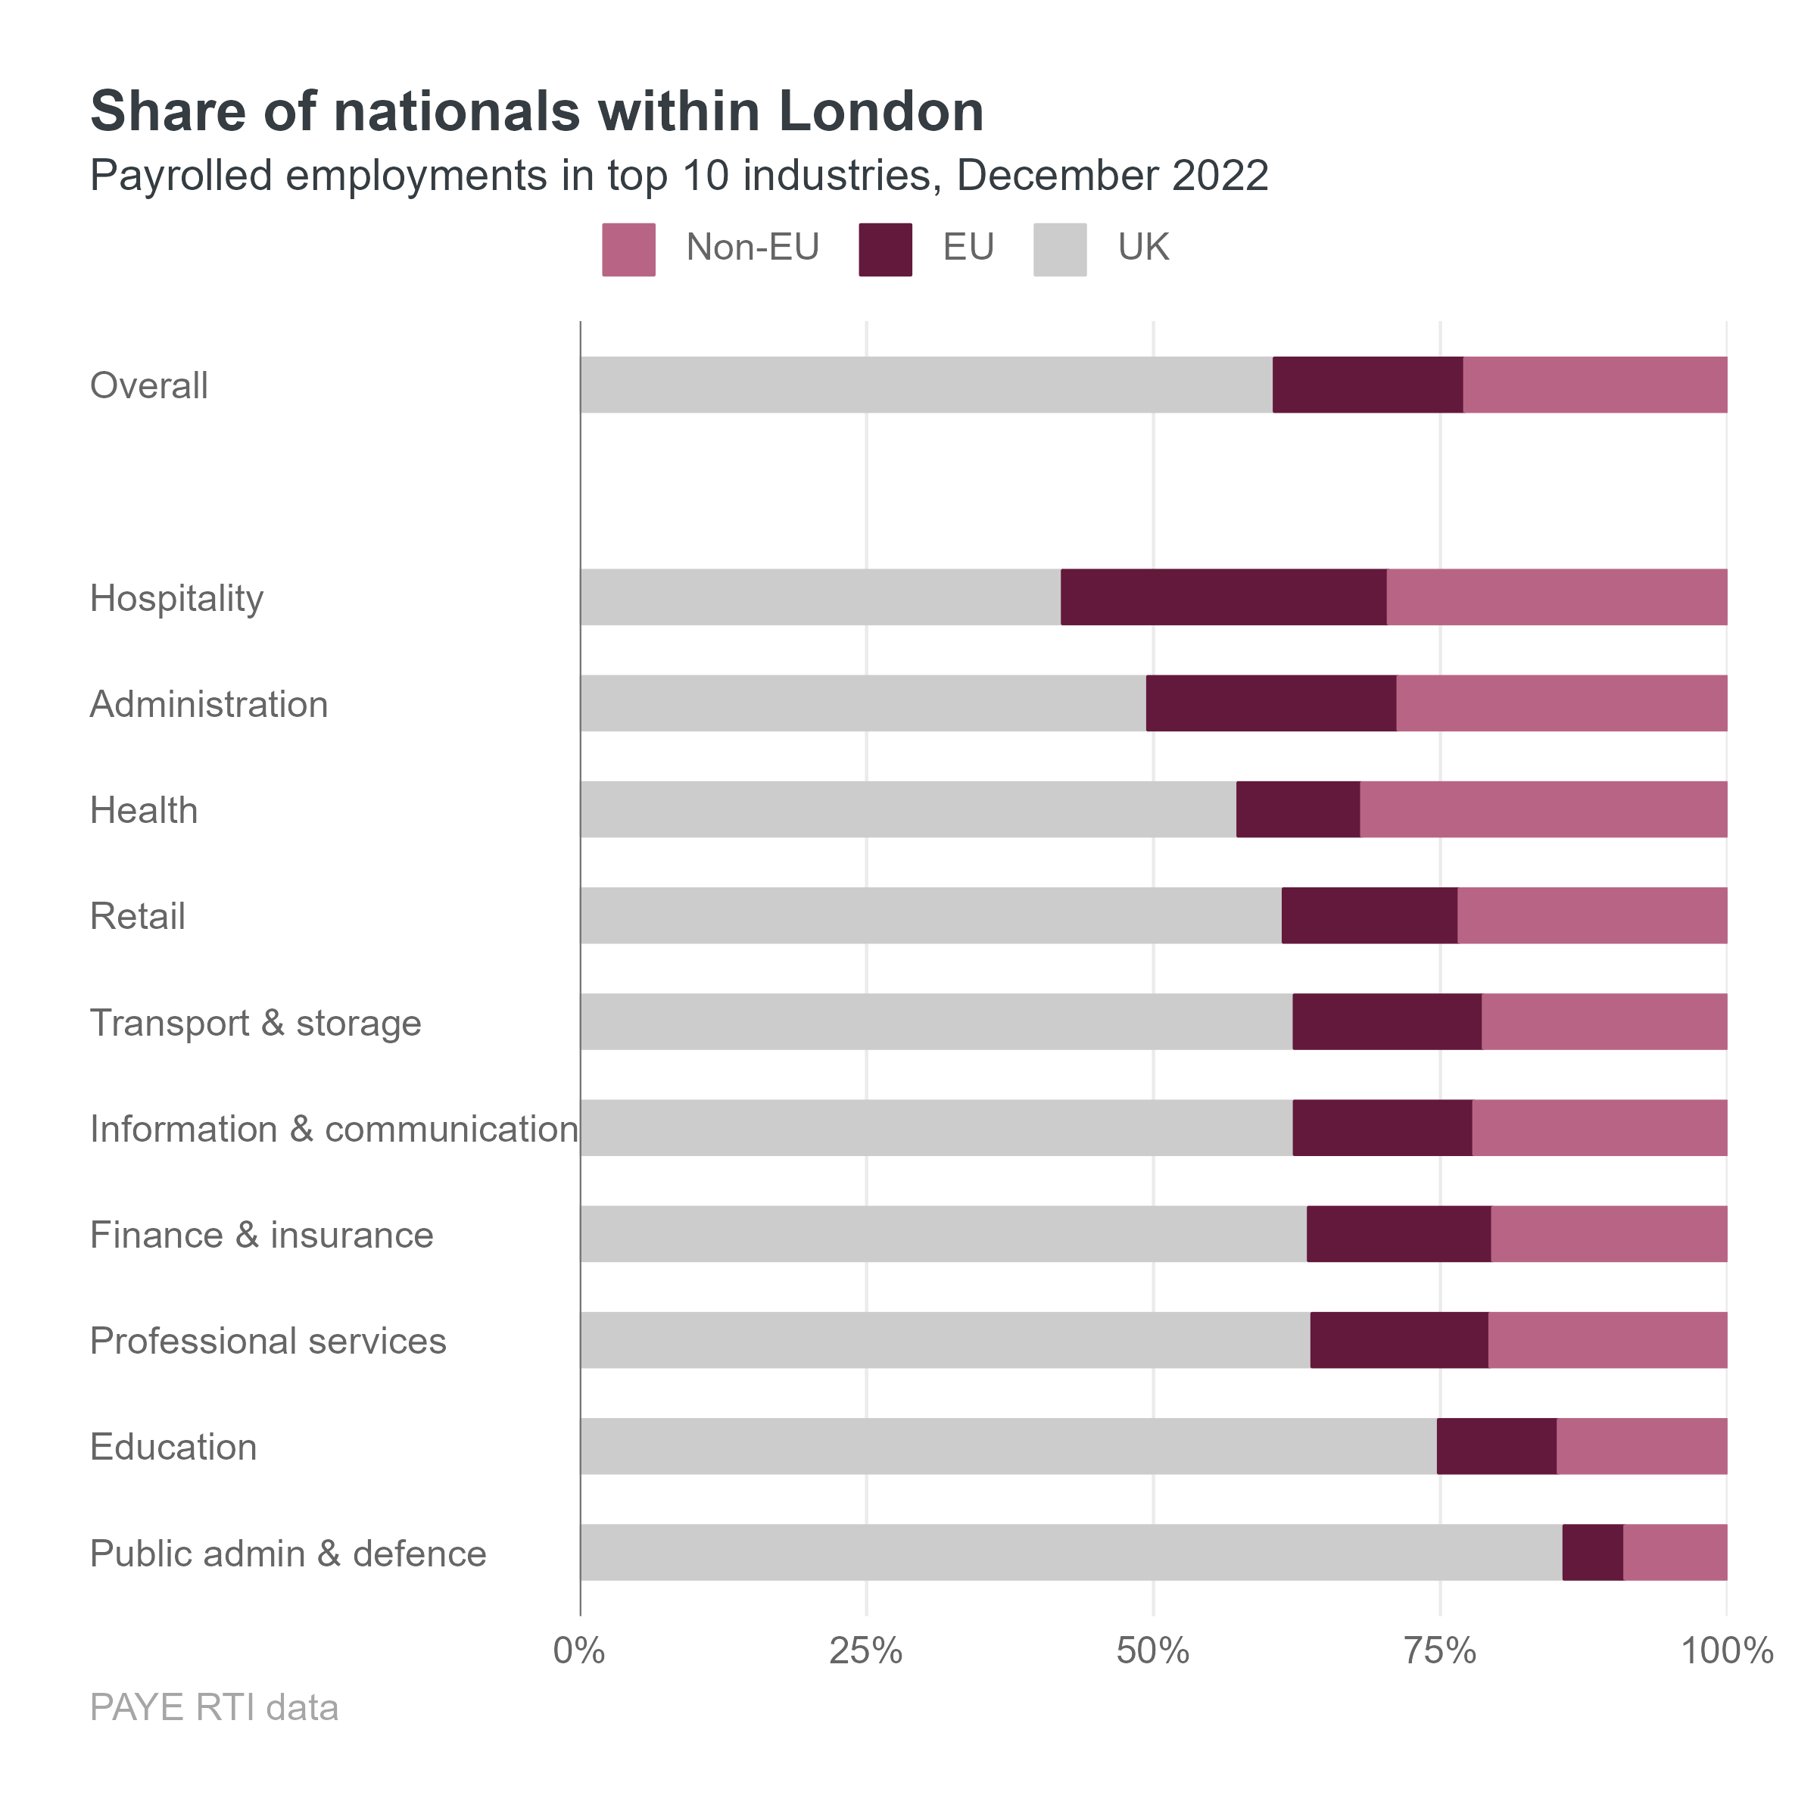

Slide 7
Thank you
For more, see our analysis on the Datastore

